Slide 1

Environmental Studies - Introduction
An Update on Major Environmental Issues, and an Introduction to Environmental Science and Sustainability

Slide 2
Definition : It deals with every aspect that affects a living organism. It is essentially a Multidisciplinary approach that bring about an appreciation of our natural world and human impact on its integrity.

Slide 3
Objectives of EVS
Awareness
Knowledge
Attitude
Skill
Participation
Notes:
Ideal Human nature:
Courage, devotion, sincerity, honesty, purity, patience, love, kindness, character, Decision making mind
Environmental ethic must relate to these human nature to be robust.

Slide 4
Importance of EVS
EVS enlighten us about the importance of protection and conservation of our environment.
EVS has become significant for the following reasons:
Environmental issues being of international importance.
Problems cropped in the wake of development.
Explosive increase in pollution.
Need for an alternative solution.
Need to save humanity from extinction.
Need for wise planning of development

Slide 5
Benefits of EVS
Conservation of energy and fast depleting natural resources.
Increase in economic productivity.
Imparting knowledge about waste management, treatment and disposal.
Develop social responsibility towards environment protection.
Creating awareness to control population.
Inculcating attitude and values towards understanding interdependence of nature, man and work towards sustainable development.

Slide 6
Major Environmental Issues
Ozone Layer Depletion
Pollution
Extinction
Global Warming
Resource Depletion
Notes:
Ask the students in class to state out some major environmental problems. Their answers will most likely fall within these 5 options. Once they have adequately answered you can show these 5 points.

Slide 7
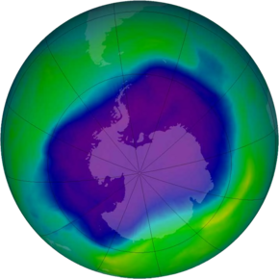
Ozone Layer Depletion
Source: wikimedia
Notes:
Explain the significance of Ozone in the atmosphere and what the ozone hole is. Ozone is a gas in the stratosphere which converts the incoming UV radiation from the sun into infrared rays by what is known as the ozone-oxygen cycle (https://en.wikipedia.org/wiki/Ozone–oxygen_cycle). In the above diagram, the blue part is the “ozone hole” over the Antarctic. It is the part of the stratosphere where the concentration of Ozone is very low.

Slide 8
Ozone is a gas in the stratosphere which converts the incoming UV radiation from the sun into infrared rays by what is known as the ozone-oxygen cycle.
In the above diagram, the blue part is the “ozone hole” over the Antarctic. It is the part of the stratosphere where the concentration of Ozone is very low.

Slide 9
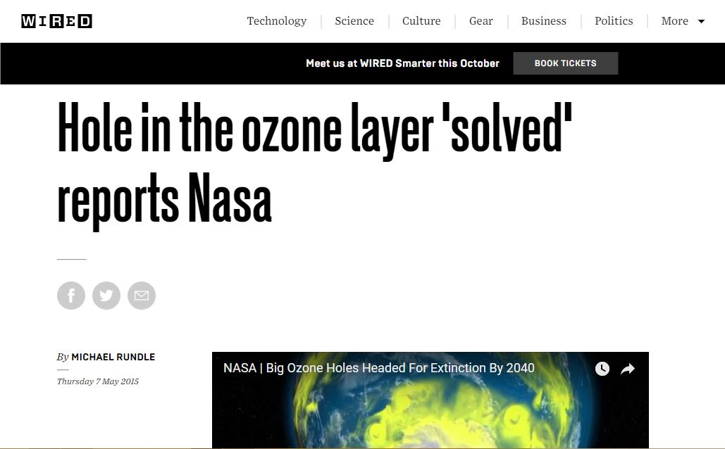
Ozone Layer Depletion- Solved!
Notes:
It is very important to explain here that the Ozone hole is no longer an issue. It is a problem we have successfully solved by imposing a worldwide ban on CFC and other Ozone Depleting substances via the Montreal Protocol (1987). Since then, the concentration of such substances in the atmosphere have stabilized or are decreasing and are soon expected to disappear. The “Ozone hole” is expected to close by 2040.

Slide 10
It is a problem we have successfully solved by imposing a worldwide ban on CFC and other Ozone Depleting substances via the Montreal Protocol (1987).
The “Ozone hole” is expected to close by 2040.

Slide 11
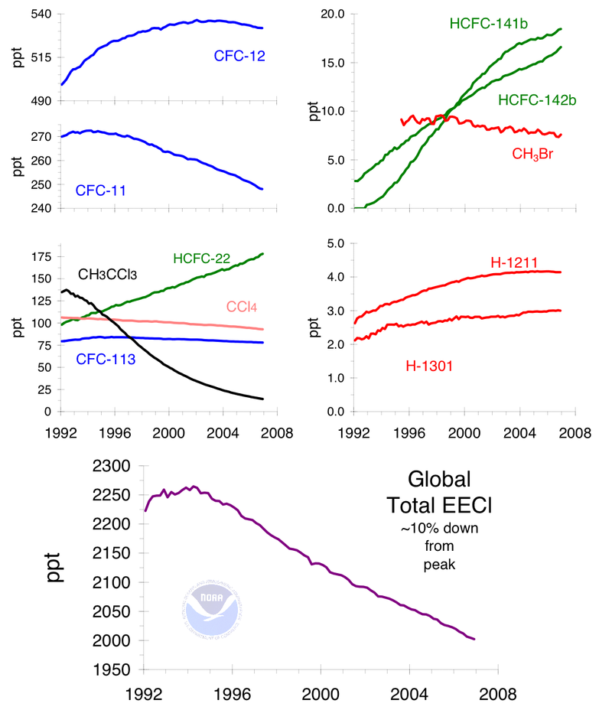
Trends of various Ozone-depleting gases like HCFC,CFC, Bromomethane, carbon tetrachloride
Source: wikimedia
Notes:
These are the trends of the ozone-depleting gases in the atmosphere. Only a few gases like HCFCs are on the rise but are expected to be phased out by 2030. Other slight rises are due to weak regulation in East Asian countries and are expected to go down as well as those countries become more developed and impose regulations more stringently. Overall, Ozone hole issue has been declared as resolved. The only reason one should discuss this problem now is to understand how the entire planet came together to solve this very complex problem. These lessons can be used to solve other, much pressing, environmental issues.
Citation for the HCFC claim: http://www.eia.gov/oiaf/1605/ggrpt/documentation/pdf/0638(2005).pdf

Slide 12
These are the trends of the ozone-depleting gases in the atmosphere. Only a few gases like HCFCs are on the rise but are expected to be phased out by 2030. Other slight rises are due to weak regulation in East Asian countries and are expected to go down as well as those countries become more developed and impose regulations more stringently. Overall, Ozone hole issue has been declared as resolved. The only reason one should discuss this problem now is to understand how the entire planet came together to solve this very complex problem. These lessons can be used to solve other, much pressing, environmental issues.

Slide 13
Major Environmental Issues
Ozone layer Depletion
Pollution
Extinction
Global Warming
Resource Depletion
Tragedy of the Commons
Notes:
It is important here to highlight that tragedy of commons is a serious issue that very few people understand, but actually encapsulates many environmental problems. Also, many environmental problems, like tragedy of the commons, cannot be solved. They can only be managed.

Slide 14
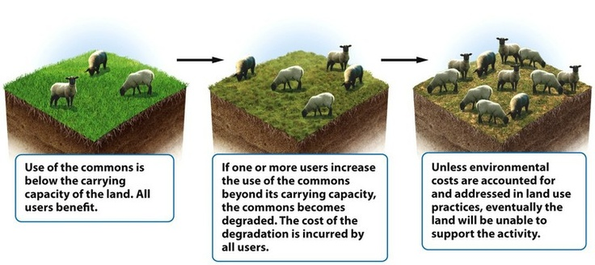
Tragedy of the Commons
Source: NTU
Notes:
“Tragedy of the commons” is a term that was first used to explain how the exploitation of common grazing lands by farmers in Great Britain and Ireland. It is a situation where on a jointly owned resource like grazing land, river, air, roads etc. (otherwise called commons), individuals acting independently based on their own self interest will cause harm to the resource and to the benefit of all the users from that resource. In the short run, the individuals acting on their self interest will benefit by shifting the burden of maintenance of the commons on the other parties, but eventually everyone will suffer from the degradation of that resource. Hence the word tragedy is used.

Slide 15
“Tragedy of the commons” is a term that was first used to explain how the exploitation of common grazing lands by farmers in Great Britain and Ireland. It is a situation where on a jointly owned resource like grazing land, river, air, roads etc. (otherwise called commons), individuals acting independently based on their own self interest will cause harm to the resource and to the benefit of all the users from that resource. In the short run, the individuals acting on their self interest will benefit by shifting the burden of maintenance of the commons on the other parties, but eventually everyone will suffer from the degradation of that resource. Hence the word tragedy is used.

Slide 16
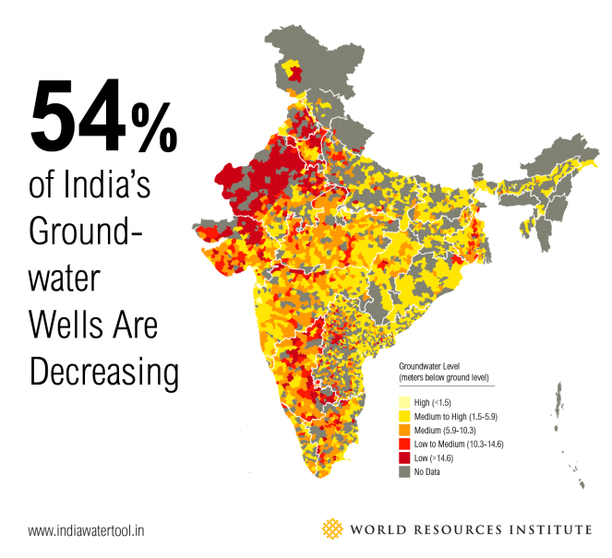
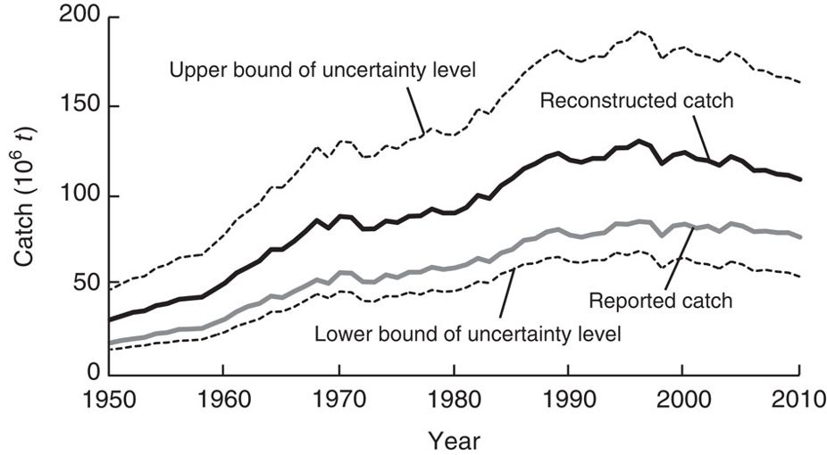
Examples of Tragedy of the Commons
Ground Water Depletion
Overfishing
World’s marine fisheries catches
Pauly D & Zeller D (2016)
Notes:
Ground water is a tragedy of the commons issue because underground water is a commons property. Individuals extract water from their bore wells but the underground aquifer is common to all. If one extracts heavily, it affects the supply of others. The graphic on the right shows this tragedy happening in India as of today.
Overfishing is commons problem because though fish stocks are a renewable resource, they are common to all fisherman and are renewable only if they can breed in the same numbers as they are being extracted. If some fishermen over extract fish, the other fishermen have a lesser fish stock to fish, straining the overall population of fish. As a result, each subsequent population of fish will be smaller than the previous causing a “tragedy” for all. In the short run, some fishermen who exploit are benefited but in the long run everyone suffers as their catch decreases. In the graph you can see the global fishing catch declining, heralding the tragedy of this commons.
Citation for the overfishing graph: Pauly, Daniel, and Dirk Zeller. "Catch reconstructions reveal that global marine fisheries catches are higher than reported and declining." Nature communications 7 (2016): 10244.

Slide 17
Ground water is a tragedy of the commons issue because underground water is a commons property. Individuals extract water from their bore wells but the underground aquifer is common to all. If one extracts heavily, it affects the supply of others. The graphic on the right shows this tragedy happening in India as of today.
Overfishing is commons problem because though fish stocks are a renewable resource, they are common to all fisherman and are renewable only if they can breed in the same numbers as they are being extracted. If some fishermen over extract fish, the other fishermen have a lesser fish stock to fish, straining the overall population of fish. As a result, each subsequent population of fish will be smaller than the previous causing a “tragedy” for all. In the short run, some fishermen who exploit are benefited but in the long run everyone suffers as their catch decreases. In the graph you can see the global fishing catch declining, heralding the tragedy of this commons.

Slide 18
Solutions?
Government Intervention?
Privatization?
Local Management?
Is there a technological solution?
There is no definite solution
Notes:
Ask the students about how they would go solving this problem? Take the simple case of the grazing lands.
Will government intervention work for all cases of this problem? How will government reinforce a single policy for each such commons (they can be quiet far apart and isolated from populated areas. They can also be very different from one another). Also, how will the govt. tackle the power disparity in each commons (one of the farmers can be much richer than the others, or could be of a higher or more influential caste) which can affect how policing works (they can influence the policing mechanisms through bribes or other such mechanisms)
Will privatization always work? Will the private owner be considerate of all necessities of all the farmers, if that means his/her profits might be less? Will they stay neutral to the power/influence imbalance in that locality?
Will local management always work? Here again you will have problems as listed for government intervention.
There is also no technology that can definitively solve this problem. This is an environmental issue with no definite solution and in many cases, no solution at all. This is a type of problem which, in many cases, cannot be solved-only managed.

Slide 19
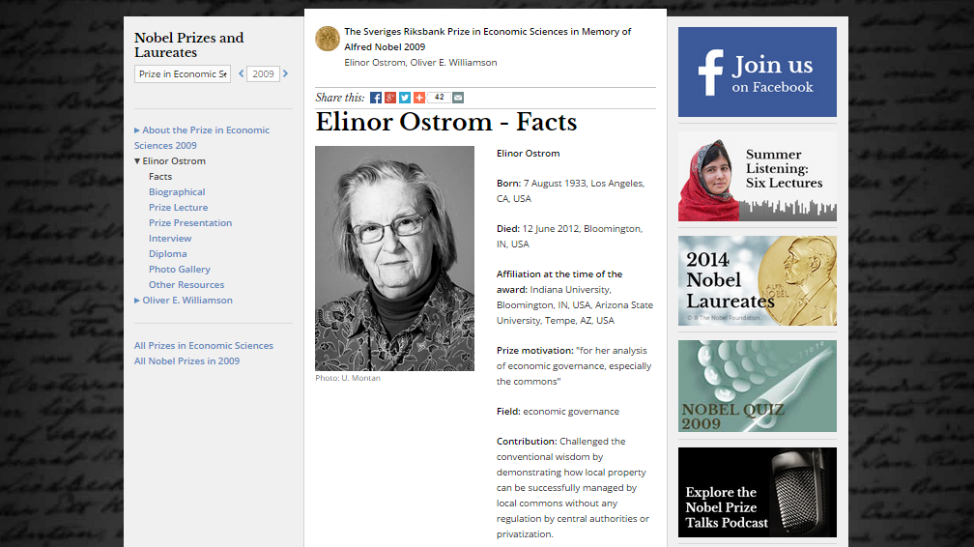
Notes:
Elinor Ostrom is the first woman to win the Nobel Prize in Economics. She won it for her work that showed for the first time that the local commons can be successfully managed by locals without any regulation by government or privatization. Till her work was seen, it was assumed that only the latter two options existed for solving this problem.

Slide 20
Elinor Ostrom is the first woman to win the Nobel Prize in Economics. She won it for her work that showed for the first time that the local commons can be successfully managed by locals without any regulation by government or privatization. Till her work was seen, it was assumed that only the latter two options existed for solving this problem.

Slide 21
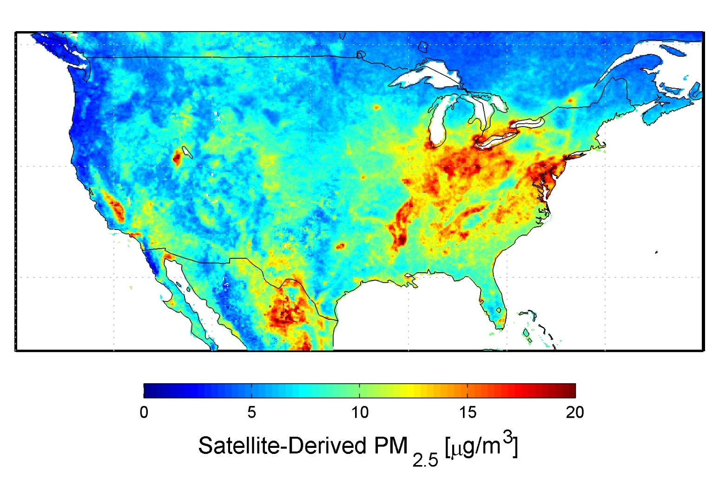
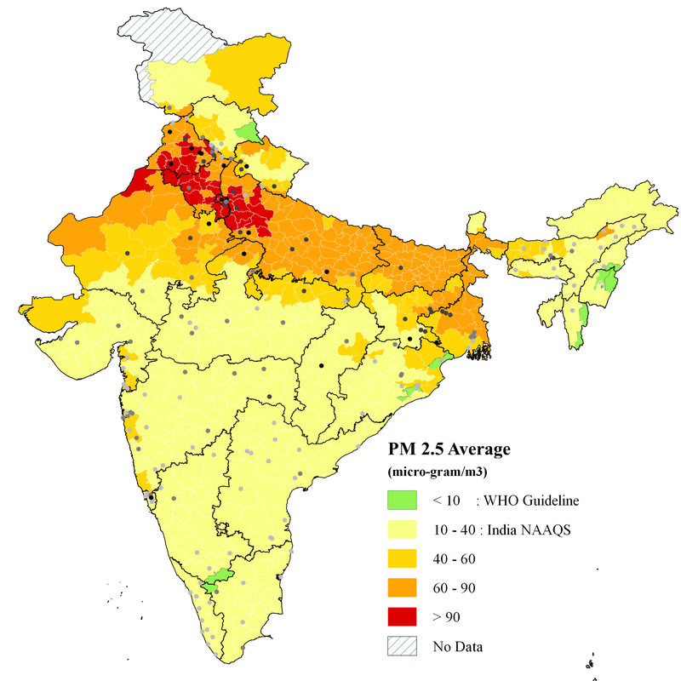
NASA
Pollution
vox.com
Notes:
Pollution is a serious problem in India. To give an example of how bad it is, take the case of Air Pollution. On the left is a map of the United States’s PM 2.5 (considered one of the most serious pollutant for human respiratory health) concentration in the atmosphere. US follows the WHO guidelines which says that up to 10 ug/m3 is safe, after which it is can be detrimental. The scale in the US map reflects this with 10 ug/m3 designated as green. The highest that scale goes to is 20ug/m3. If the PM2.5 goes to this level, they usually announce health advisory and generally discourage people from going out of their houses.
The India map on the right shows the conc. of the same PM 2.5 in the country in the same units. India follows the NAAQS ( National Ambient Air Quality Standards) which is a standard it formed itself. As you can observe, the NAAQS limit is 4 times above WHO limits. And even with these exaggerated limits, many parts of the country to do not satisfy it. If at 20 ug/m3, the US announces health advisories, what is the condition of respiratory health of people in India? We will get back to this graph in the later chapter on pollution to understand why we have such lax standards. Please refer to pg 131 in book (environmental reader for universities) for more details.

Slide 22
Pollution is a serious problem in India. To give an example of how bad it is, take the case of Air Pollution. On the left is a map of the United States PM 2.5 (considered one of the most serious pollutant for human respiratory health) concentration in the atmosphere. US follows the WHO guidelines which says that up to 10 ug/m3 is safe, after which it is can be detrimental. The scale in the US map reflects this with 10 ug/m3 designated as green. The highest that scale goes to is 20ug/m3. If the PM2.5 goes to this level, they usually announce health advisory and generally discourage people from going out of their houses.

Slide 23
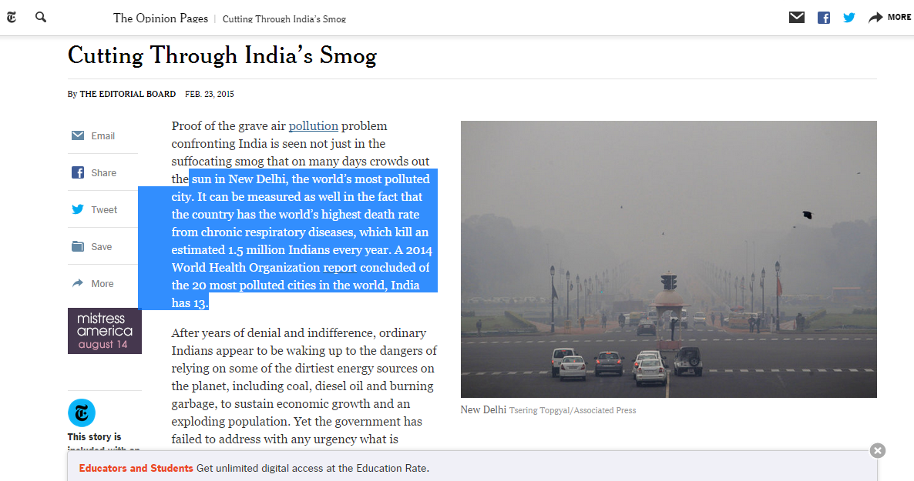
nytimes.com
Notes:
It is of no surprise then that we have one of the highest death rate related to chronic respiratory issues. And of the 20 most polluted cities in the world, we are home to 13. As shown in this article from New York Times.

Slide 24
It is of no surprise then that we have one of the highest death rate related to chronic respiratory issues. And of the 20 most polluted cities in the world, we are home to 13. As shown in this article from New York Times.

Slide 25
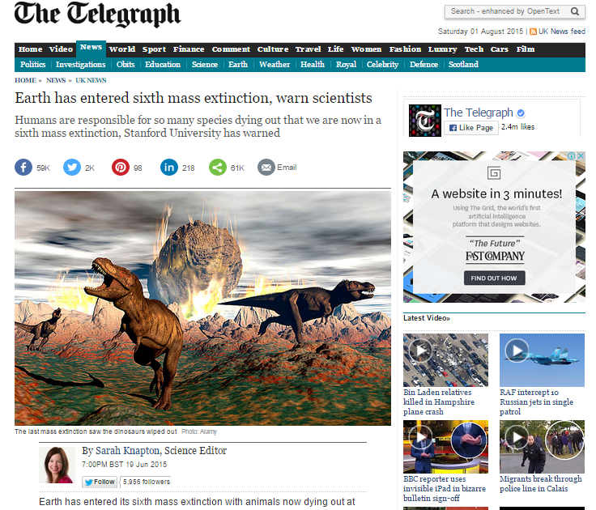
Extinction
Notes:
Though we know extinction is happening, what is surprising is the rate at which it is happening. It is so fast that scientists now think that the 6th mass extinction has begun. In many instances, we are losing species faster than we are discovering them.

Slide 26
Though we know extinction is happening, what is surprising is the rate at which it is happening. It is so fast that scientists now think that the 6th mass extinction has begun. In many instances, we are losing species faster than we are discovering them.

Slide 27
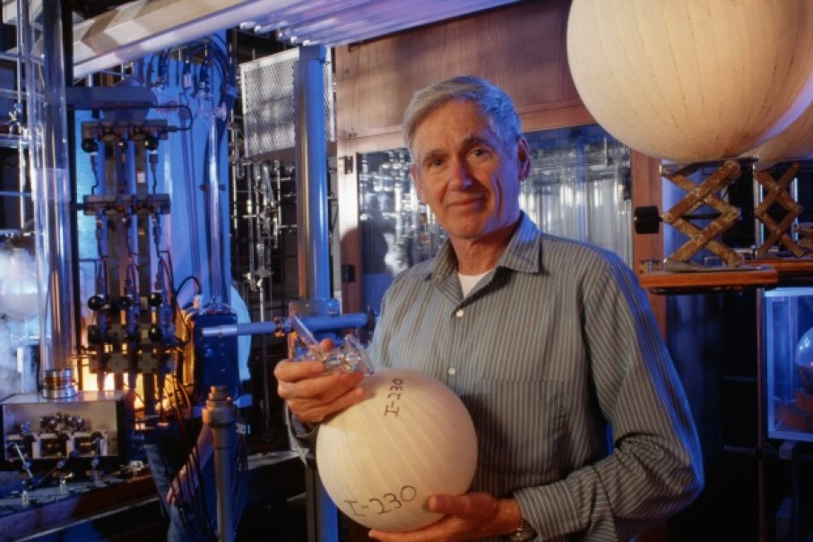
Courtesy: howstuffworks.com
Charles David Keeling
Notes:
To understand this, it is important to look at the work of Charles David Keeling. He was a geochemist who built the first instrument to take precise measurements of CO2 in the atmosphere and took preliminary readings from Mauna Loa in Hawaii. Before his work, the CO2 measurements in the atmosphere varied quiet a bit and were wholly unreliable. Mauna Loa was chosen as the first test site because it is away from the mainland US and as winds come from the ocean to the mainland, the readings he would get would not contaminated by local influence such as cars and industries. He would truly get the average conc. of CO2 in the atmosphere.

Slide 28
To understand this, it is important to look at the work of Charles David Keeling. He was a geochemist who built the first instrument to take precise measurements of CO2 in the atmosphere and took preliminary readings from Mauna Loa in Hawaii. Before his work, the CO2 measurements in the atmosphere varied quiet a bit and were wholly unreliable. Mauna Loa was chosen as the first test site because it is away from the mainland US and as winds come from the ocean to the mainland, the readings he would get would not contaminated by local influence such as cars and industries. He would truly get the average conc. of CO2 in the atmosphere.

Slide 29
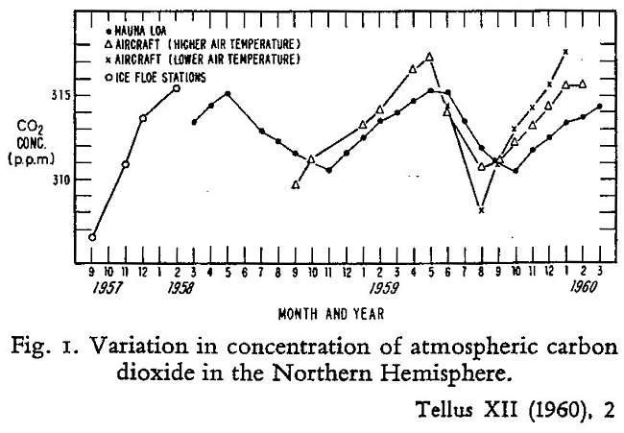
Notes:
He took readings from 1957 to 1960. He also sent copies of his instruments to ice floe station in the South Pole and high and low altitude aircrafts. The graph is the result of his measurements. It has three major breakthroughs. First, that the CO2 conc. in the atmosphere is not a constant. It varies according to season. In the spring and summer seasons, trees grow leaves in the northern hemisphere which reduces the amount of CO2 in the atmosphere. In fall and winter seasons, these trees shed leaves and also lose their CO2, which causes a rise of CO2 in the atmosphere. Second breakthrough was that if you were draw a trend line through this graph, you would see a slight uptick. He roughly calculated this uptick is at the same rate of fossil fuel emissions in the world. Third, though the rate is the same, the total estimated quantity of CO2 increase in the atmosphere is not the same as the amount emitted in the atmosphere by fossil fuels. He conjectured that some of it was being absorbed by natural systems like forests and oceans (and hence not all of it was being absorbed back by earth systems).

Slide 30
He took readings from 1957 to 1960. He also sent copies of his instruments to ice floe station in the South Pole and high and low altitude aircrafts. The graph is the result of his measurements. It has three major breakthroughs. First, that the CO2 conc. in the atmosphere is not a constant. It varies according to season. In the spring and summer seasons, trees grow leaves in the northern hemisphere which reduces the amount of CO2 in the atmosphere. In fall and winter seasons, these trees shed leaves and also lose their CO2, which causes a rise of CO2 in the atmosphere. Second breakthrough was that if you were draw a trend line through this graph, you would see a slight uptick. He roughly calculated this uptick is at the same rate of fossil fuel emissions in the world. Third, though the rate is the same, the total estimated quantity of CO2 increase in the atmosphere is not the same as the amount emitted in the atmosphere by fossil fuels. He conjectured that some of it was being absorbed by natural systems like forests and oceans (and hence not all of it was being absorbed back by earth systems).

Slide 31
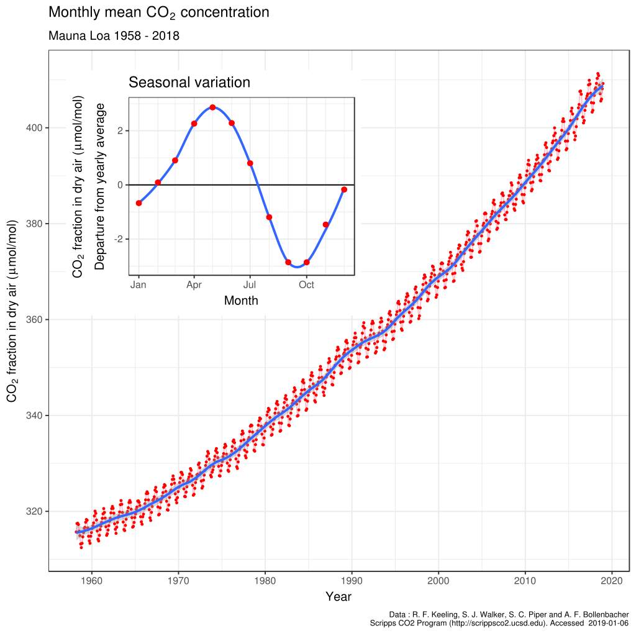
The Keeling Curve
Notes:
Though some of his results were controversial at that time, his measurements gained enough support to secure funds and set up a permanent observatory in Mauna Loa. The graph above is the result of this effort. Though somewhat vaguely present in his 1960 graph, this one shows a clear uptick in the CO2 conc. and an increase of roughly 100ppm of CO2 in the atmosphere since 1957. Mauna Loa is now the worlds longest continuous CO2 measuring station. In commemoration of his efforts, this curve is now called “The Keeling curve”. It has been heralded as one of the most influential scientific works of our time.

Slide 32
Though some of his results were controversial at that time, his measurements gained enough support to secure funds and set up a permanent observatory in Mauna Loa. The graph above is the result of this effort. Though somewhat vaguely present in his 1960 graph, this one shows a clear uptick in the CO2 conc. and an increase of roughly 100ppm of CO2 in the atmosphere since 1957. Mauna Loa is now the worlds longest continuous CO2 measuring station. In commemoration of his efforts, this curve is now called “The Keeling curve”. It has been heralded as one of the most influential scientific works of our time.

Slide 33
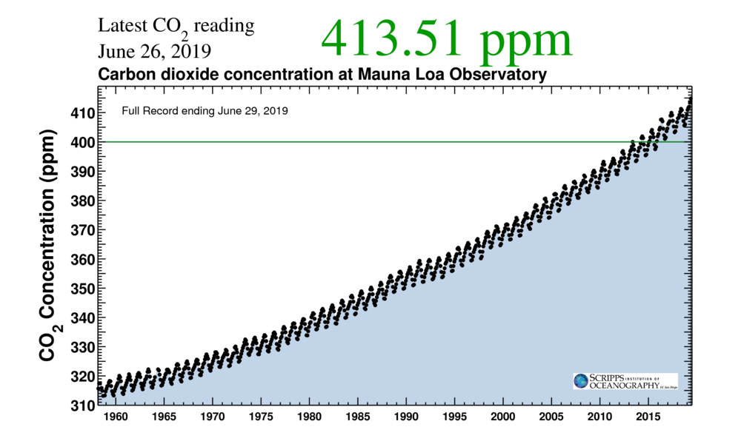
So what?
The Keeling Curve
Notes:
This is the latest reading of CO2 conc. in the atmosphere. It is important to ask why this value should be taken seriously. So what if the value of CO2 conc. in atmosphere is 413.51ppm. So what if it is roughly 100ppm more than the first measurement in 1957. That does not mean anything without proper context. For this, one needs to look at ice core data.

Slide 34
This is the latest reading of CO2 conc. in the atmosphere. It is important to ask why this value should be taken seriously. So what if the value of CO2 conc. in atmosphere is 413.51ppm. So what if it is roughly 100ppm more than the first measurement in 1957. That does not mean anything without proper context. For this, one needs to look at ice core data.

Slide 35

Ice Core
Courtesy: The Telegraph
Notes:
Ice cores look like this. They are cylindrical blocks of ice dug out of from permafrost. Permafrost as the name suggests is permanent frost. In certain places in the world, like the poles, when snow forms in the winter, it never melts. When this snow forms, it traps small air pockets within itself, and as snow forms every winter every year, each year forms a layer of ice over the last years ice deposit. If one were to dig vertically into these layers and extract the air pockets from each layer of ice, you would get a temporal scale of atmospheric composition of the planet. You can use this composition to decipher the amount of CO2 in the atmosphere and also the ambient temperature of the planet in that year.

Slide 36
Ice cores look like this. They are cylindrical blocks of ice dug out of from permafrost. Permafrost as the name suggests is permanent frost. In certain places in the world, like the poles, when snow forms in the winter, it never melts. When this snow forms, it traps small air pockets within itself, and as snow forms every winter every year, each year forms a layer of ice over the last years ice deposit. If one were to dig vertically into these layers and extract the air pockets from each layer of ice, you would get a temporal scale of atmospheric composition of the planet. You can use this composition to decipher the amount of CO2 in the atmosphere and also the ambient temperature of the planet in that year.

Slide 37
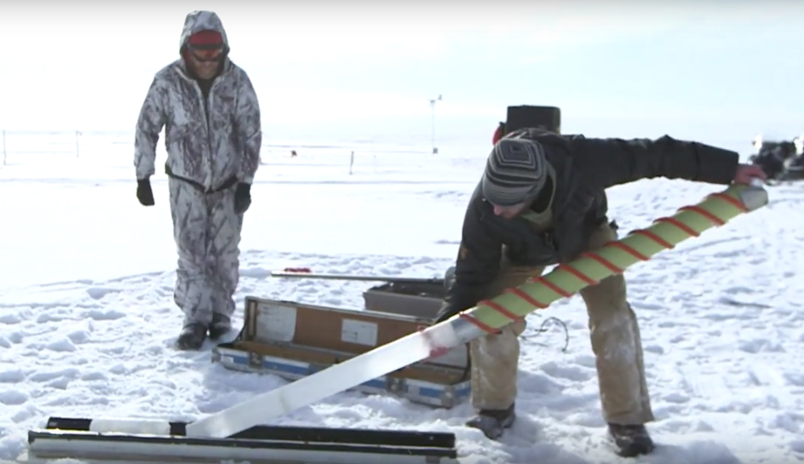
Ice Core Drilling
Courtesy: Frontier Scientists

Slide 38
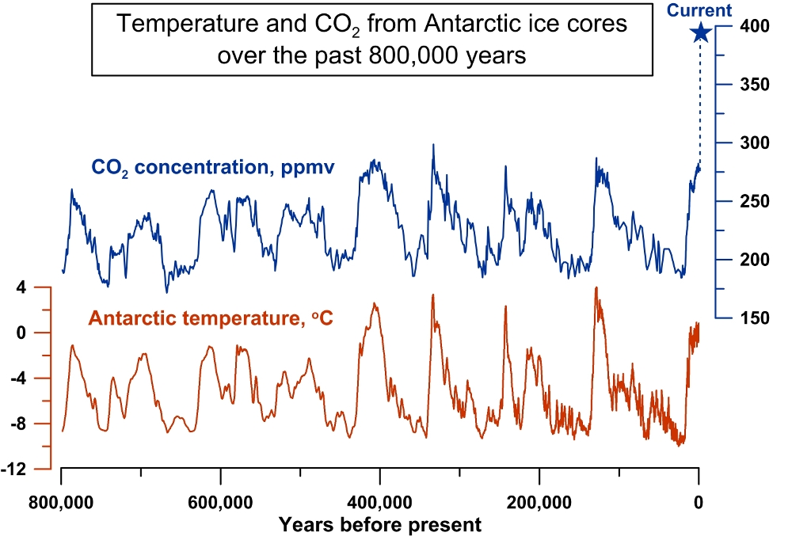
Image credit: Havard/Jeremy Shakun
Notes:
Scientists have been able to reconstruct earth’s CO2 and avg. Antarctic temperature history for the past 800,000 years through ice cores data. In this graph, each trough represents an ice age. In the last 800,000 years, we have seen 7 ice ages. As is evident from this graph, Earth is presently coming out of an ice age. As is also clear from the graph, temperature and CO2 are strongly correlated (the relationship between them though, is not linear). This is where the concern is raised. If CO2 and temp are correlated, and if every time CO2 has increased in the atmosphere, the Earth has warmed enough to come out of an ice age, what will the current amount of CO2 do to the present climate. As is clear from the graph, earth has never seen so much CO2 in the atmosphere in its past 800000 year history. This excess CO2 is clearly a cause of major concern and is entirely due to man made reasons. There is nothing natural about this CO2 conc. in the atmosphere.

Slide 39
Scientists have been able to reconstruct earth’s CO2 and avg. Antarctic temperature history for the past 800,000 years through ice cores data. In this graph, each trough represents an ice age. In the last 800,000 years, we have seen 7 ice ages. As is evident from this graph, Earth is presently coming out of an ice age. As is also clear from the graph, temperature and CO2 are strongly correlated (the relationship between them though, is not linear). This is where the concern is raised. If CO2 and temp are correlated, and if every time CO2 has increased in the atmosphere, the Earth has warmed enough to come out of an ice age, what will the current amount of CO2 do to the present climate. As is clear from the graph, earth has never seen so much CO2 in the atmosphere in its past 800000 year history. This excess CO2 is clearly a cause of major concern and is entirely due to man made reasons. There is nothing natural about this CO2 conc. in the atmosphere.

Slide 40
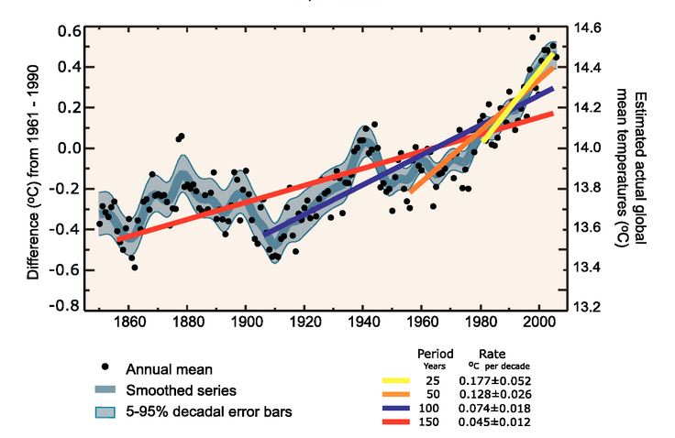
IPCC, 2007A
Notes:
This problem is further made worse by the fact that the rate of change of CO2, as shown in the graph has accelerated despite our efforts to curtail it in the last couple of decades. This shows that all the measures we have taken till date to tackle this issue have been woefully inadequate.

Slide 41
This problem is further made worse by the fact that the rate of change of CO2, as shown in the graph has accelerated despite our efforts to curtail it in the last couple of decades. This shows that all the measures we have taken till date to tackle this issue have been woefully inadequate.

Slide 42
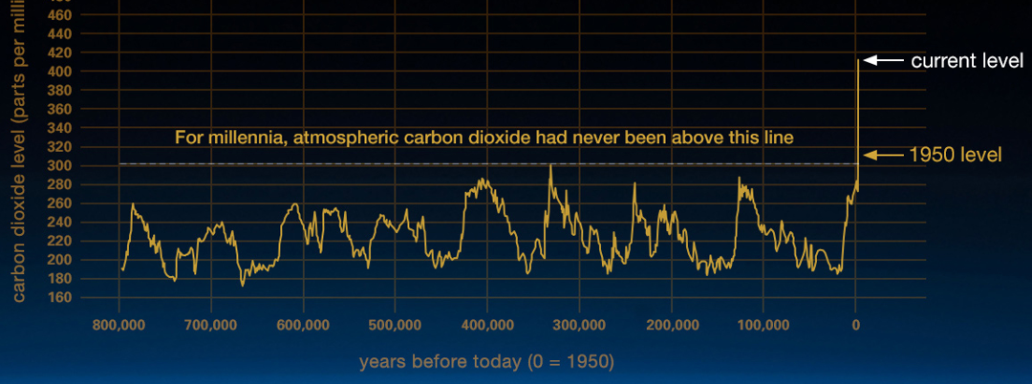
This graph, based on the comparison of atmospheric samples contained in ice cores and more recent direct measurements, provides evidence that atmospheric CO₂ has increased since the Industrial Revolution. (Credit: Luthi, D., et al.. 2008; Etheridge, D.M., et al. 2010; Vostok ice core data/J.R. Petit et al.; NOAA Mauna Loa CO₂ record.)

Slide 43
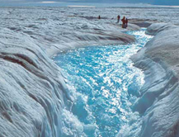
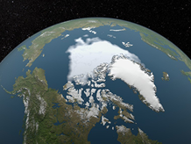
Evidences
1.Shrinking ice sheets : The Greenland and Antarctic ice sheets have decreased in mass. Data from NASA's Gravity Recovery and Climate Experiment show Greenland lost an average of 286 billion tons of ice per year between 1993 and 2016, while Antarctica lost about 127 billion tons of ice per year during the same time period.
2.Declining Arctic sea ice : Both the extent and thickness of Arctic sea ice has declined rapidly over the last several decades. ( Image: Visualization of the 2012 Arctic sea ice minimum, the lowest on record)
Source : UCAR centre for science education

Slide 44

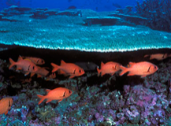
3.Extreme events : The number of record high temperature events in the United States has been increasing, while the number of record low temperature events has been decreasing, since 1950. The U.S. has also witnessed increasing numbers of intense rainfall events.
4.Ocean acidification : Since the beginning of the Industrial Revolution, the acidity of surface ocean waters has increased by about 30 percent. This increase is the result of humans emitting more carbon dioxide into the atmosphere and hence more being absorbed into the oceans. The amount of carbon dioxide absorbed by the upper layer of the oceans is increasing by about 2 billion tons per year.
Source : UCAR centre for science education

Slide 45
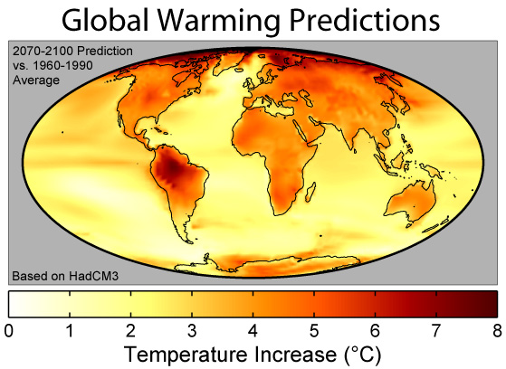
Notes:
Another layer of complexity to this problem comes when you take this data and try to predict what is going to happen in the future. Because Earth is a non-linear dynamical system, it is hard to anticipate how the future of climate is going to look.

Slide 46
Another layer of complexity to this problem comes when you take this data and try to predict what is going to happen in the future. Because Earth is a non-linear dynamical system, it is hard to anticipate how the future of climate is going to look.

Slide 47
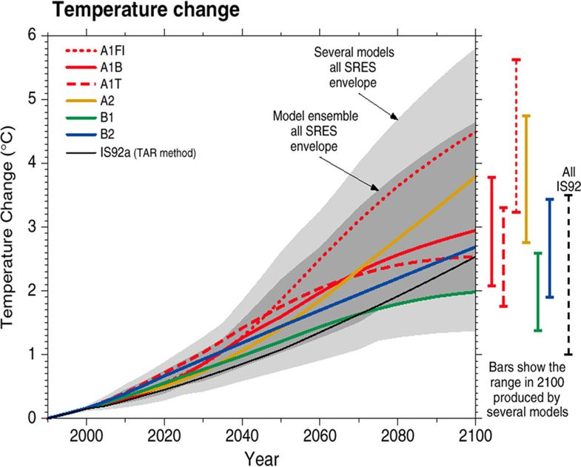
Temperature change under different scenarios
Notes:
This is a graph of temperature change in the year 2100 under different scenarios. Each line represents a different model which takes into different, but equally valid assumptions about how the temperature of planet will rise. As you can see, the variation is quite large. It ranges from about 1.5 C to about 6 C which, is quiet a large difference. 6 C change will mean evacuation of many coastal areas and islands around the world. 1.5 C change will mean slight but manageable sea level rise. Both those extreme scenarios require diametrically opposite policy interventions.

Slide 48
This is a graph of temperature change in the year 2100 under different scenarios. Each line represents a different model which takes into different, but equally valid assumptions about how the temperature of planet will rise. As you can see, the variation is quite large. It ranges from about 1.5 degree C to about 6 degree C which, is quiet a large difference. 6 degree C change will mean evacuation of many coastal areas and islands around the world. 1.5 degree C change will mean slight but manageable sea level rise. Both those extreme scenarios require diametrically opposite policy interventions.

Slide 49
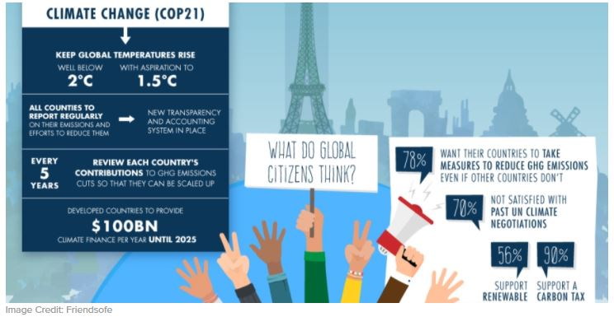
Notes:
COP21 or otherwise known as the Paris Climate Agreement, signed in 2015, has the ambitious goal of keeping global temperature rise by 2100 to below 2 C with aspirations to keep it below 1.5 C. These goals are nearly unattainable keeping in mind the projections seen in previous slide.

Slide 50
COP21 or otherwise known as the Paris Climate Agreement, signed in 2015, has the ambitious goal of keeping global temperature rise by 2100 to below 2 degree C with aspirations to keep it below 1.5 degree C. These goals are nearly unattainable keeping in mind the projections seen in previous slide.

Slide 51
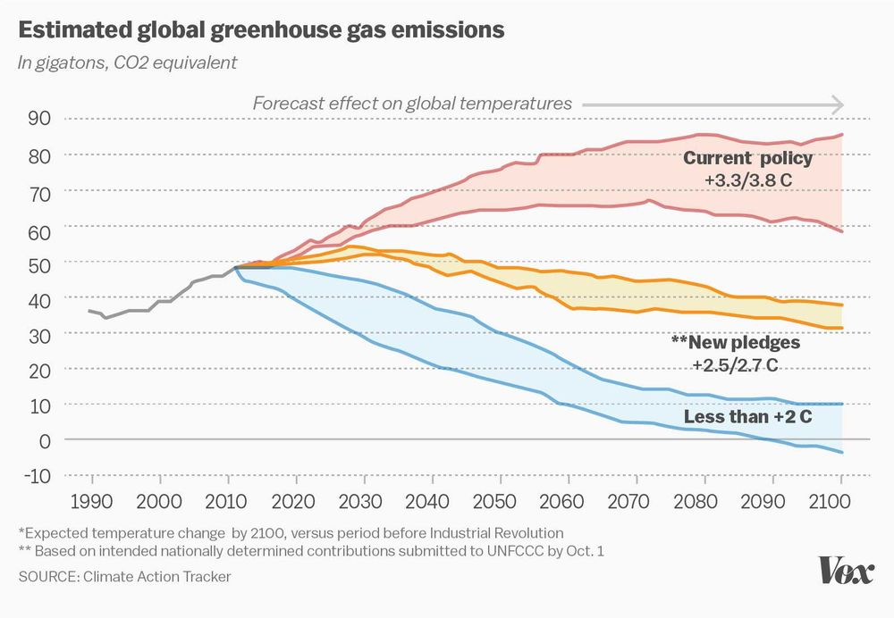
Notes:
This graph highlights this issue. Even with the current policies, we are realistically looking at about 4 C rise, which is catastrophic. Some new proposed environmental policies are expected to bring this down to 2.5-2.7 C but nothing close to the 2 C or 1.5 C COP21 goals.

Slide 52
This graph highlights this issue. Even with the current policies, we are realistically looking at about 4 degree C rise, which is catastrophic. Some new proposed environmental policies are expected to bring this down to 2.5-2.7 degree C but nothing close to the 2 degree C or 1.5 degree C as per COP21 goals.

Slide 53
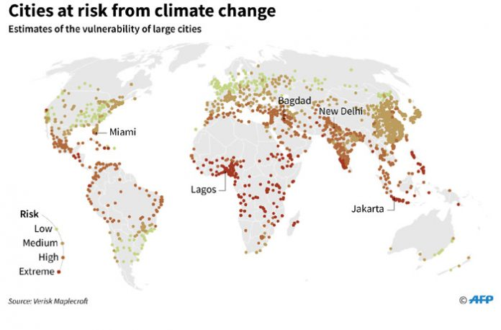
Notes:
India and other developing countries will disproportionately suffer from the consequences of the failure of such policies.

Slide 54
Sustainable Development

Slide 55
Sustainable Development (SD)
“Development that meets the needs of the present without compromising the ability of future generation to meet their own needs”
1987 report of the World Commission on Environment and Development (WCED).

Slide 56
What is Sustainable about Development?
What is development?
How do you measure sustainability in the current paradigm of development?
Is your definition of sustainability in line with environmental sustainability?
Notes:
To understand the term sustainable development truly, it is first important to understand what we mean by development and also sustainability. And then see if these two definitions are in line with each other.

Slide 57
What is development?
Definition of Development:
Gross Domestic Product (GDP)
“GDP measures the monetary value of final goods and services—that is, those that are bought by the final user—produced in a country in a given period of time”- IMF
Measurement of throughput of natural resources
Notes:
In our world, development is primarily defined by GDP. Lesser developed economies have lower GDP. Developed economies have higher GDP. Therefore, for development to happen GDP must rise. But, GDP is actually a measure of how much natural resources are consumed. So resource consumption must increase for development to happen.

Slide 58
In our world, development is primarily defined by GDP. Lesser developed economies have lower GDP. Developed economies have higher GDP. Therefore, for development to happen GDP must rise. But GDP is actually a measure of how much natural resources are consumed. So, resource consumption must increase for development to happen.

Slide 59
Challenges to Sustainable Development
Rising income inequality ( Economical Kuznets curve)
Environmental degradation ( Environmental Kuznets curve)
Economical Kuznets curve : Refers to relating growth and income redistribution.
Environmental Kuznets curve : Refers to relating growth and environment.

Slide 60
How to measure sustainability?
For the case of development- Sustainable growth
For the case of the environment- Environmental sustainability
Environmental sustainability requires that we don’t consume nonrenewable resources. In such a scenario, GDP should be close to zero.
Sustainable Growth ≠ Environmental Sustainability
Notes:
Therefore, for development to happen at a regular pace, we need a “sustainable” GDP growth. But this means that we are increasing our resource consumption at a regular pace.
Environmental sustainability requires that we don’t consume non-renewable resources since any consumption of such resources will reduce the environment as an entity.
Therefore, sustainable growth and environmental sustainability necessarily cannot be the same thing.

Slide 61
Therefore, for development to happen at a regular pace, we need a “sustainable” GDP growth. But this means that we are increasing our resource consumption at a regular pace.
Environmental sustainability requires that we don’t consume non-renewable resources since any consumption of such resources will reduce the environment as an entity.
Therefore, sustainable growth and environmental sustainability necessarily cannot be the same thing.

Slide 62
Why do we use GDP as a metric for overall improvement in human life?

Slide 63
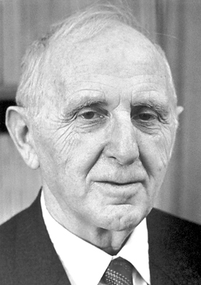
Simon Kuznets
Notes:
Simon Kuznets was the first person to introduce the concept of GDP to understand year on year development rate of a country and quantify it. Before his time, industrial growth of was only measured in indirect terms and was very vague. This lead to serious issues in framing proper economic policies. The great US depression of 1929 is a good example of the problems caused by this vague understanding. He was also the first person to collect data for the US and some European countries to calculate their GDPs.

Slide 64
Simon Kuznets was the first person to introduce the concept of GDP to understand year on year development rate of a country and quantify it. Before his time, industrial growth was only measured in indirect terms and was very vague. This lead to serious issues in framing proper economic policies. The great US depression of 1929 is a good example of the problems caused by this vague understanding. He was also the first person to collect data for the US and some European countries to calculate their GDPs.

Slide 65
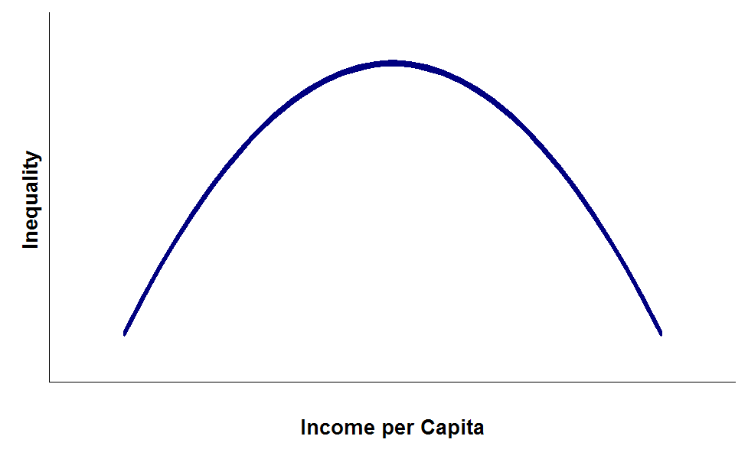
Kuznets Curve
Courtesy: Wikipedia.org
Notes:
While he was collecting this data, he observed that as the income per capita increases, so does the income inequality of the country, but only up to a certain point. Any subsequent increase in the income per capita then decreases Inequality. He did not comment on how this happens or why it happens. Just that it happens. He even said that this conclusion was ““Perilously close to pure guesswork” as the data he was working with was very limited. But, nonetheless, it became very popular especially for many underdeveloped/developing economies. The policy for removing income inequality was now simple. Just focus on GDP (Income per capita as an aggregate will be GDP). As long as the GDP rose, inequality would rise but at some point come down on its own. Take the case of the western economies. They are on the right hand side of this curve and their income inequality is low. India is somewhere near the top left side of the curve and our inequality is high. Intuitively, this graph makes sense.

Slide 66
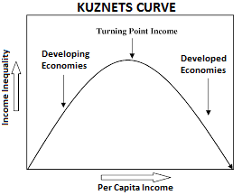

Slide 67
While he was collecting this data, he observed that as the income per capita increases, so does the income inequality of the country, but only up to a certain point.
Any subsequent increase in the income per capita then decreases Inequality. He did not comment on how this happens or why it happens. Just that it happens. He even said that this conclusion was ““Perilously close to pure guesswork” as the data he was working with was very limited.
But, nonetheless, it became very popular especially for many underdeveloped/developing economies. The policy for removing income inequality was now simple. Just focus on GDP (Income per capita as an aggregate will be GDP).
As long as the GDP rose, inequality would rise but at some point come down on its own. Take the case of the western economies. They are on the right hand side of this curve and their income inequality is low. India is somewhere near the top left side of the curve and our inequality is high. Intuitively, this graph makes sense.

Slide 68
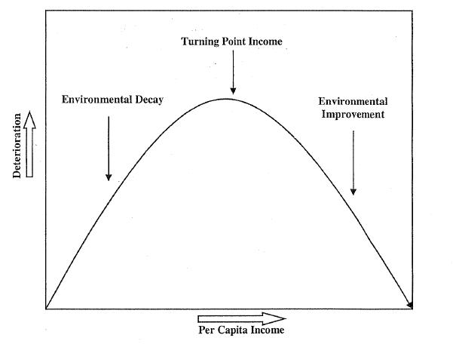
Environmental Kuznets Curve (EKC)
Courtesy: perc.org
Notes:
This understanding got carried forward to the environment as well. As a country is developing, it will consume resources at a rate which will cause environmental decay, but after a certain point, environmental decay will come to a halt and will start to improve. Again, if you take the case of Europe and India, it makes intuitive sense. Europe is rich enough to spend some of its income on protection of their environment. India is not quite there yet and is seeing destruction of its environment. Many developing countries are doing worse. This is an amazing insight for a policy maker or the government. With this and the previous graph combined, what it means for them is that if they focus just on growing the GDP, though in the short term inequality and environmental destruction will rise, in the long run both of those major issues will be resolved automatically.

Slide 69
This understanding got carried forward to the environment as well. As a country is developing, it will consume resources at a rate which will cause environmental decay, but after a certain point, environmental decay will come to a halt and will start to improve.
Again, if you take the case of Europe and India, it makes intuitive sense. Europe is rich enough to spend some of its income on protection of their environment. India is not quite there yet and is seeing destruction of its environment. Many developing countries are doing worse. This is an amazing insight for a policy maker or the government.
With this and the previous graph combined, what it means for them is that if they focus just on growing the GDP, though in the short term inequality and environmental destruction will rise, in the long run both of those major issues will be resolved automatically.

Slide 70
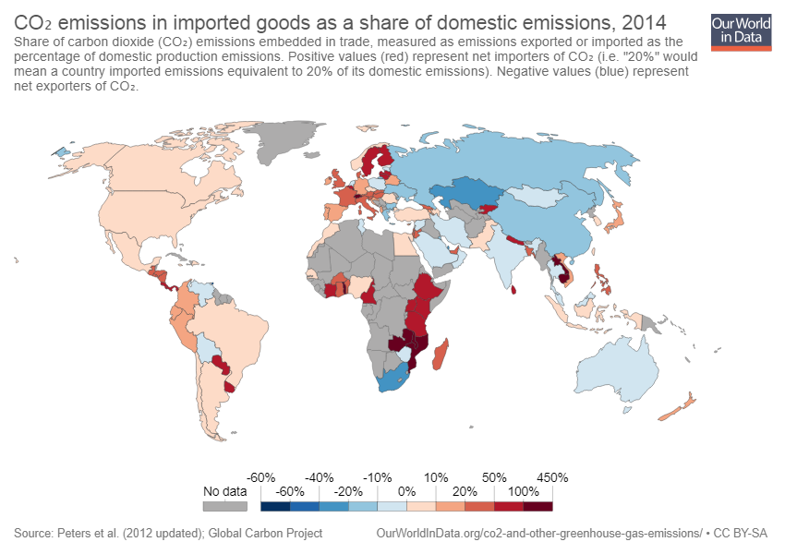
Notes:
But lets stop to think about how the EKC actually works. Take the case of Europe. Europe is very sensitive to its environment and have very stringent rules for its protection. But does that mean they have low carbon footprints? No! On the contrary it has one of the highest per capita CO2 emissions of the world. It manages to have a clean environment by shifting the onerous of doing polluting jobs to other countries and importing the products from them. This allows them to be clean while also causing environmental degradation. This is clearly not a sustainable way to reduce environmental degradation in the world as countries like India and China also “develop”. The EKC is right if you take countries in isolation but very wrong when taken for the whole world. There is therefore a need to move to better policies to reduce environmental degradation and actually develop sustainably.

Slide 71
But lets stop to think about how the EKC actually works. Take the case of Europe. Europe is very sensitive to its environment and have very stringent rules for its protection. But does that mean they have low carbon footprints? No! On the contrary it has one of the highest per capita CO2 emissions of the world. It manages to have a clean environment by shifting the onerous of doing polluting jobs to other countries and importing the products from them. This allows them to be clean while also causing environmental degradation. This is clearly not a sustainable way to reduce environmental degradation in the world as countries like India and China also “develop”. The EKC is right if you take countries in isolation but very wrong when taken for the whole world. There is therefore a need to move to better policies to reduce environmental degradation and actually develop sustainably.

Slide 72
Thank you

